Slide 1
Lecture #2
SOFT COMPUTING
INT508

Slide 2

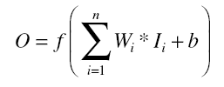
The Activation Function
The activation function performs several important tasks
One of the more important of which is to introduce nonlinearity to the network.
Another important feature of the activation function is its ability to limit the neuron’s output.
The complete mathematical function of the artificial neuron can be given as:
where f is any activation function

Slide 3
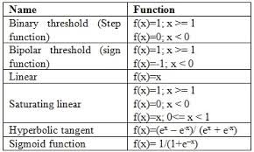
Common Activation Functions
Note: f(x) = tanh(x) = 2/(1 + e^{-2x}) – 1 = 2 * sigmoid(2x) - 1

Slide 4
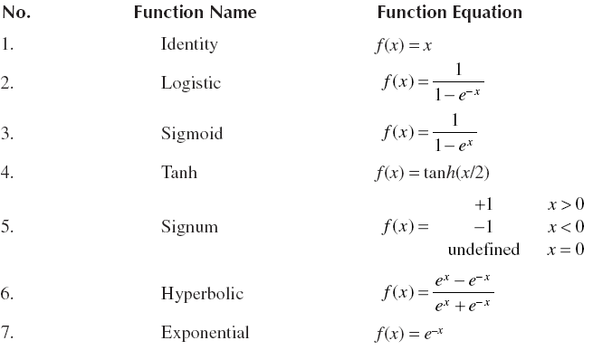
Common Activation Functions

Slide 5
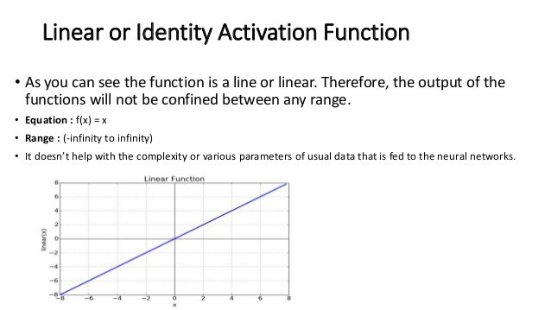
Common Activation Functions

Slide 6
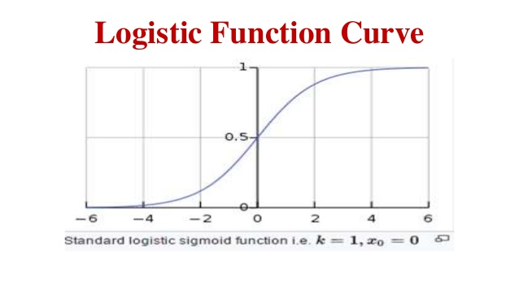
Common Activation Functions

Slide 7
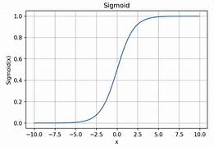
Common Activation Functions

Slide 8
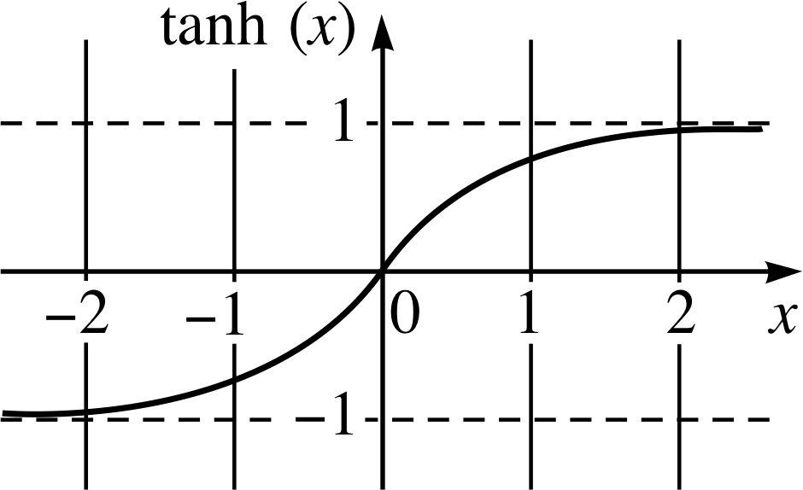
Common Activation Functions

Slide 9
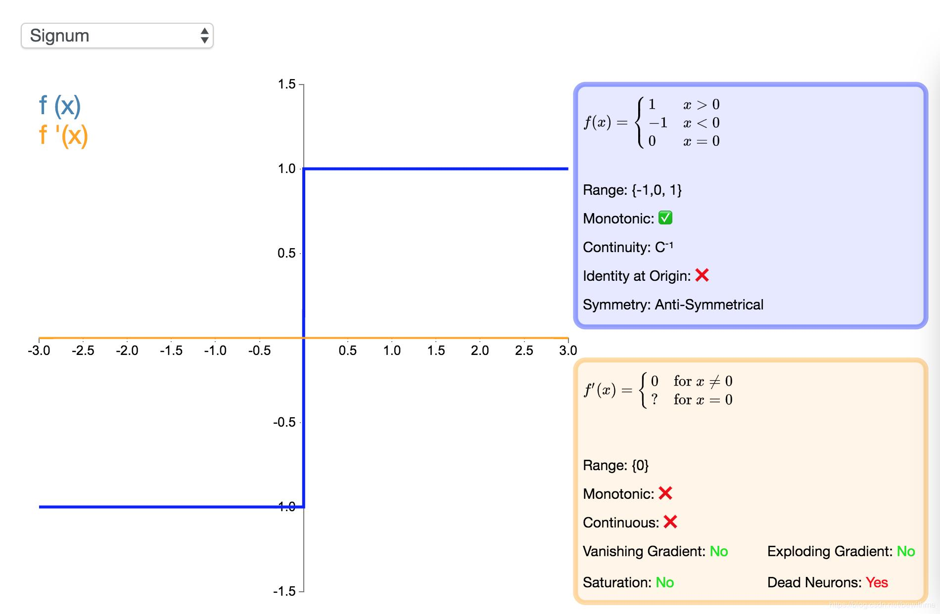
Common Activation Functions

Slide 10
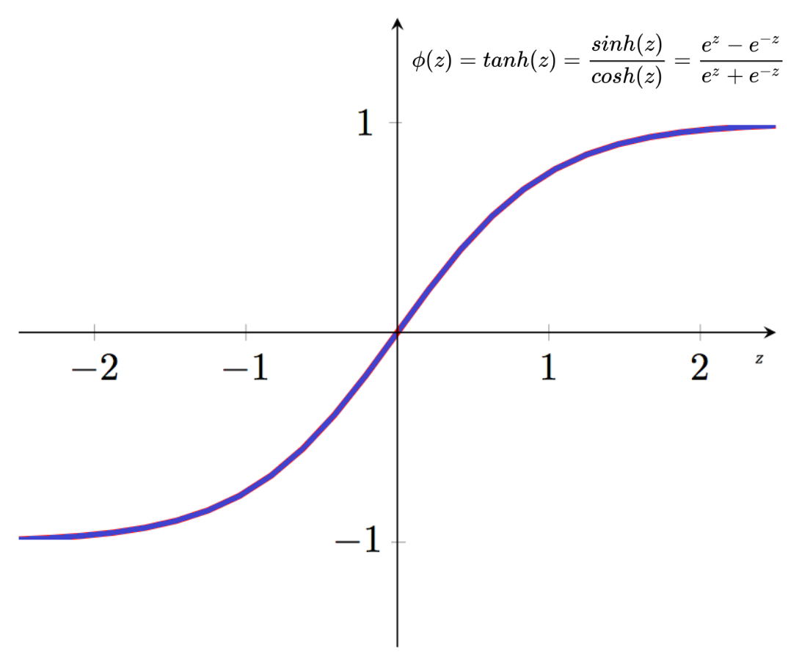
Common Activation Functions

Slide 11
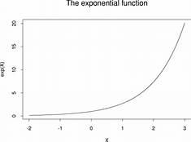
Common Activation Functions

Slide 12
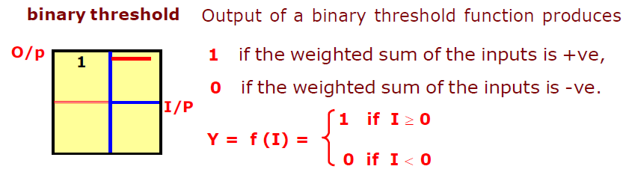
Common Activation Functions

Slide 13
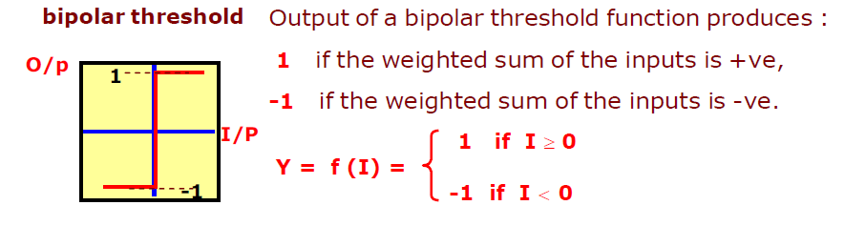
Common Activation Functions

Slide 14
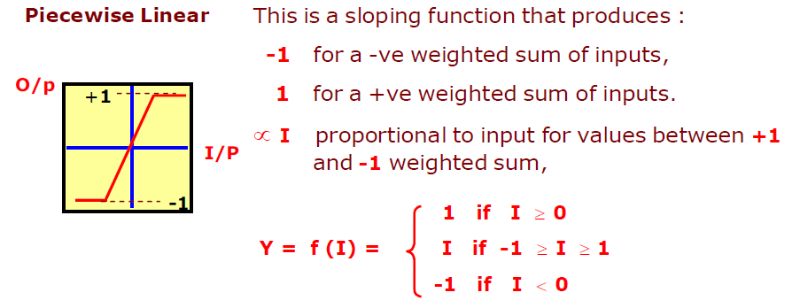
Common Activation Functions

Slide 15
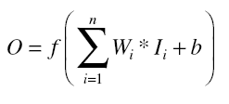
Example
Calculate the output for a neuron. The inputs are (0.10, 0.90, 0.05), and the corresponding weights are (2, 5, 2). Bias is given to be 1. The activation function is linear. Also draw the neuron architecture.
Solution:
Using Equation, we have
where I1 = 0.1, W1 = 2, I2 = 0.9, W2 = 5, I3 = 0.05, W3 = 2, and b = 1.
f(x)=x
Hence the neuron’s output is
  f(W1 * I1 + W2 * I2 + W3 * I3)
  = f(2 * 0.1 + 5 * 0.9 + 2 * 0.05)
  = f(0.2 + 4.5 + 0.1)
  = f(4.8)
  =4.8

Slide 16

Example
Calculate the output for a neuron. The inputs are (0.10, 0.90, 0.05), and the corresponding weights are (2, 5, 2). Bias is given to be 0. The activation function is logistic. Also draw the neuron architecture.
Solution:
Using Equation, we have
where I1 = 0.1, W1 = 2, I2 = 0.9, W2 = 5, I3 = 0.05, W3 = 2, and b = 0.
Hence the neuron’s output is
  f(W1 * I1 + W2 * I2 + W3 * I3)
  = f(2 * 0.1 + 5 * 0.9 + 2 * 0.05)
  = f(0.2 + 4.5 + 0.1)
  = f(4.8)
  = 1.008

Slide 17
Example
Calculate the output for a neuron. The inputs are (0.10, 0.90, 0.05), and the corresponding weights are (2, 5, 2). Bias is given to be 0. The activation function is Binary. Also draw the neuron architecture.
Solution:
Using Equation, we have
where I1 = 0.1, W1 = 2, I2 = 0.9, W2 = 5, I3 = 0.05, W3 = 2, and b = 0.
Hence the neuron’s output is
  f(W1 * I1 + W2 * I2 + W3 * I3)
  = f(2 * 0.1 + 5 * 0.9 + 2 * 0.05)
  = f(0.2 + 4.5 + 0.1)
  = f(4.8)
  = 1

Slide 18

12/12/14
CSE510, Lovely Professional University, Phagwara

